Slide 1

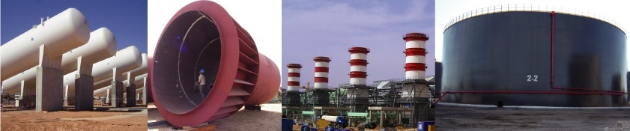
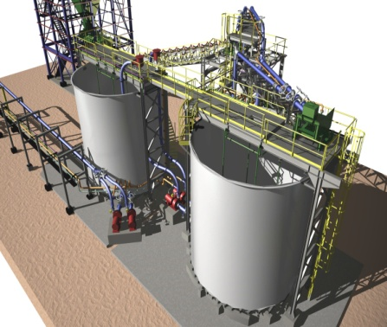
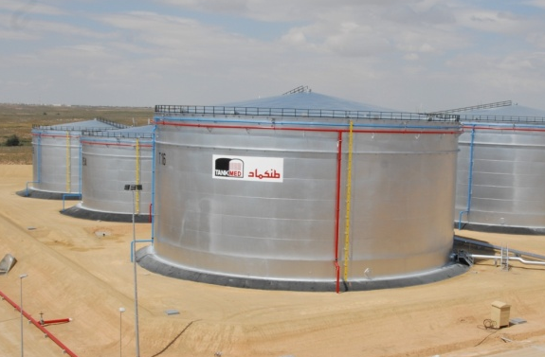
INDUSTRIAL ENGINEERING TECHNOLOGIES
GENERAL PRESENTATION
www.iet-engineering.com

Slide 2
Summary
1
Overview
2
Activities
3
Areas of Expertise
4
References

Slide 3
Overview
Main Company Data
 | INDUSTRIAL ENGINEERING TECHNOLOGIES
IET Creation Date | 2004
IET Employees | 30
Area of Activities | Engineering of Industrial Projects
Address | St. Med Hedi Khefacha 3000 Sfax - Tunisia
Specialities | Engineering of Industrial Plants

Slide 4
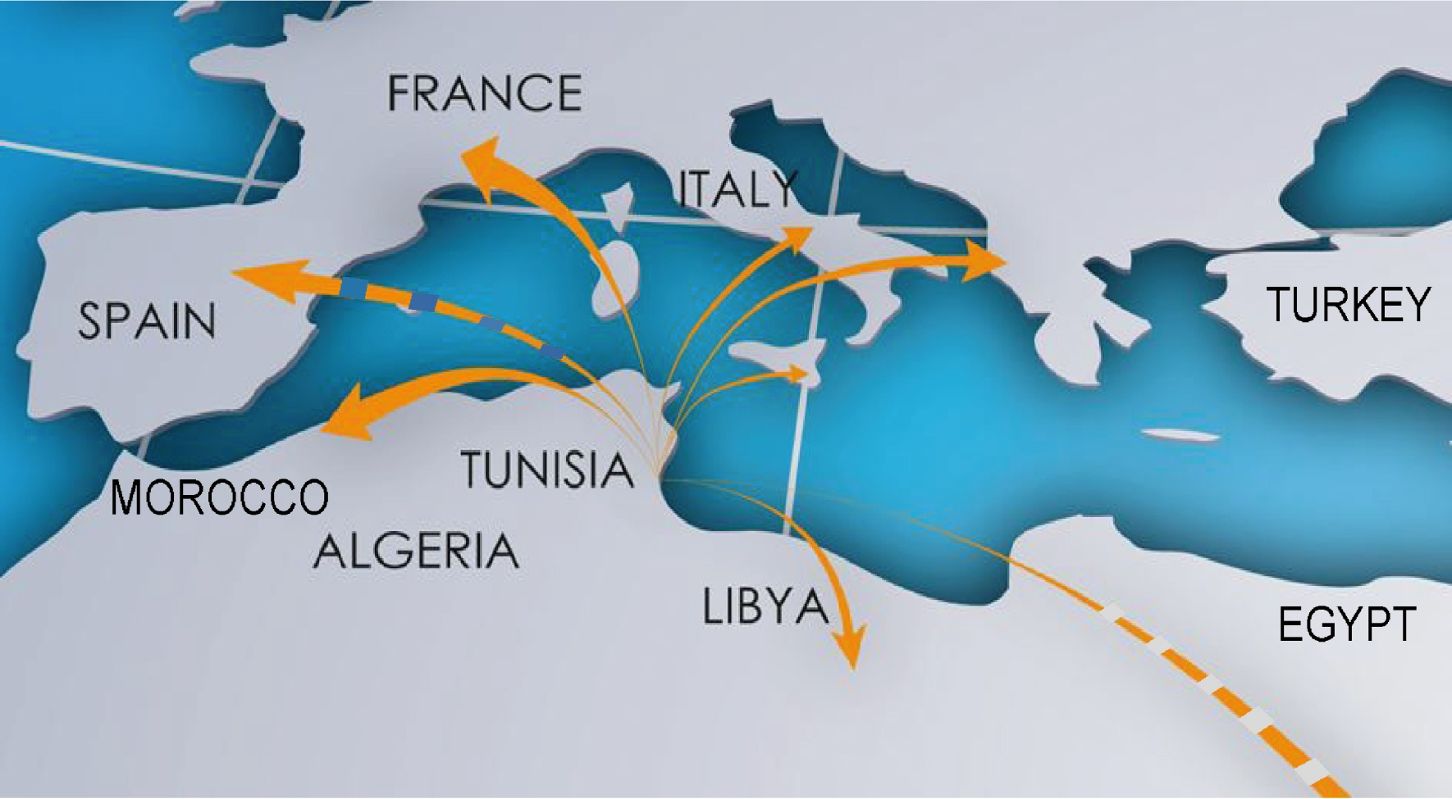
Overview
Strategic Position
IET has succeeded in establishing excellent relationships with many international companies.

Slide 5
Overview
Organization
General Direction
Commercial Department
Administrative & Financial Department
Information Technology Department
Technical Direction
Mechanical & Piping Department
Electrical & Instrumentation Department
Civil & Steel Structure Department
Process
Department
Quality Department
Project Management Department

Slide 6
Summary
1
Overview
2
Activities
3
Areas of Expertise
4
References

Slide 7
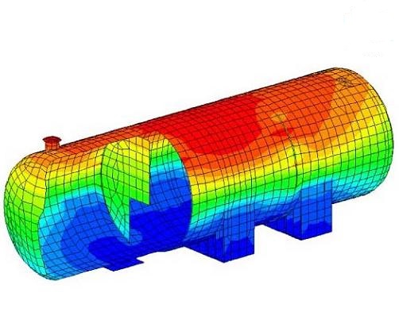
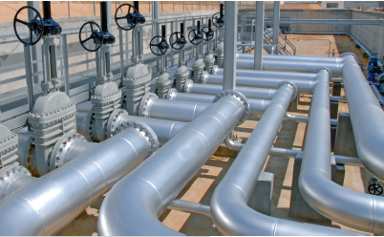
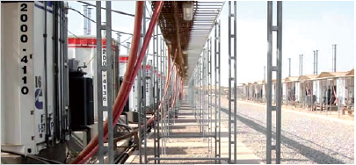
Activities
Engineering
Mechanical & Piping Department:
Plant 3D Modeling, ISO generation, Piping Flexibility Analysis
Mechanical Equipment detailed Design:
Pressure Vessel, Atmospheric Tanks, Heat Exchanger,
Separators Packages, Conveyor, etc.
Process Department:
Oil & Gas Unit Simulation (Separation Unit, Dehydration Unit, Stabilization Unit, etc.)
Hydraulic System Design (Pumping Stations,
Surge Design, Steady State Network Analysis, etc.)
P&IDs Generation, Flow Sheet Generation
Electrical & Instrumentation Department:
LV & HV Distribution Network, Substation
Instrument and Control System Design
PCS and PLC System Design
Fire and Gas Detection System
Grounding and Lighting System Design
Cathodic Protection design

Slide 8
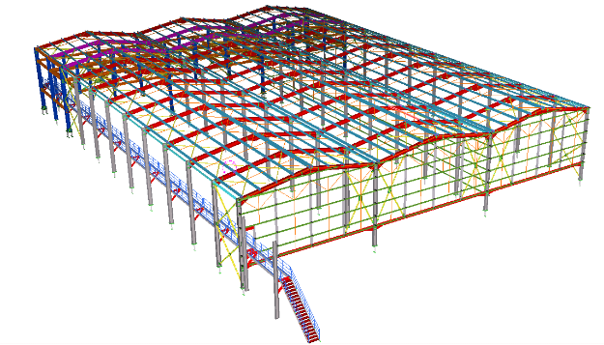

Activities
Engineering
Civil & Structure Department
Industrial Foundations, Drainage Systems, Offices & Buildings
Deep Foundation Design
Onshore and Offshore Steel Structure detailed Design
Steel Structure 3D Modeling
Management Department
Project Planning & Executing
Project Monitoring and control
Ensuring quality and quantity production
Ensuring communications with Customer

Slide 9
Activities
Engineering Tools
:
:
:
:
:
:
:
:
:
:
CADWorx, AutoCAD Plant 3D, SolidWorks
PV ELITE, AMETank
CEBELMAIL
CAESAR II
Robot Structural Analysis, Staad Pro
TEKLA Structures, REVIT Structures
Aspen HYSYS
AutoCAD Plant 3D
HTRI
CANECO HT/BT & ETAP
Plant Design
Pressure Vessel and Tank Design
Steady State and Transient Hydraulic Analysis
Piping Flexibility & Stress Analysis
Concrete & Steel Structure Design
Steel Structure Detail
Process Design
Piping & Instrumentation Diagram
Heat Transfer
Electrical HV/LV Systems Design

Slide 10
Summary
1
Overview
2
Activities
3
Areas of Expertise
4
References

Slide 11
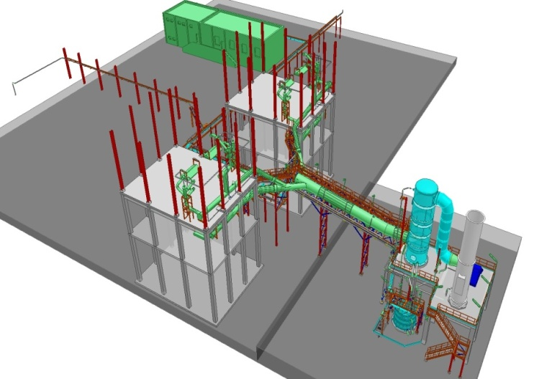
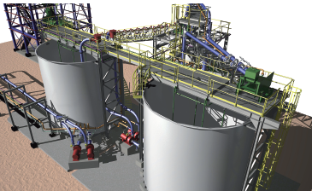
Areas of Expertise
Cement & Chemical Industries
Chemical activity
Sulfuric Acid Plant
Phosphate Pulp Unit
TSP Unit (triple superphosphate fertilizer)
and DAP Unit (Diammonium Phosphate)
Ammonium Storage Facilities
Transportation of products by conveyor, railway etc.

Slide 12
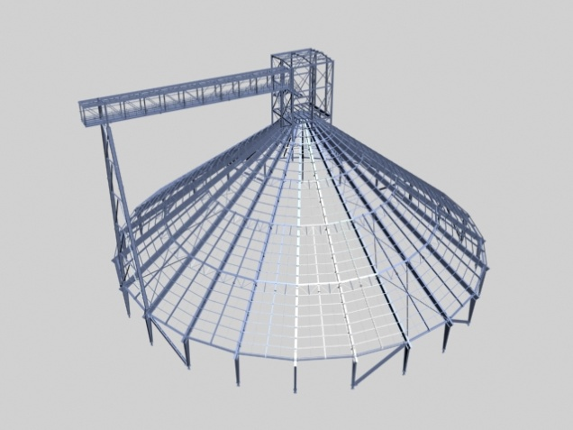
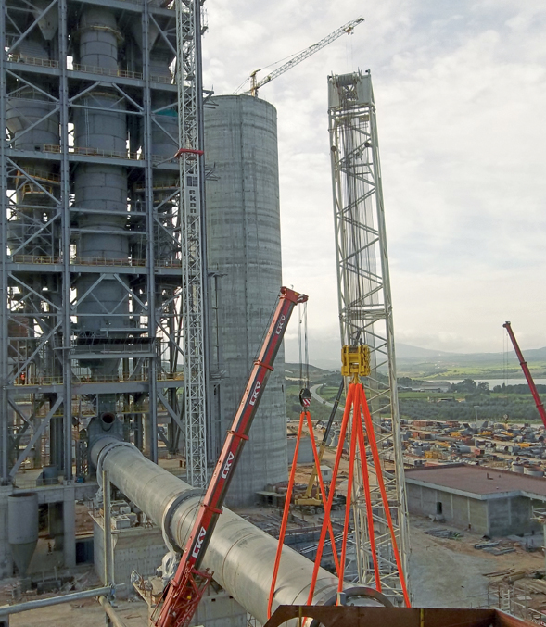
Areas of Expertise
Cement & Chemical Industries
  Clinker Installations
  Fine Material Storage Area
  Preheating Tower
  Rotating Kiln
12

Slide 13
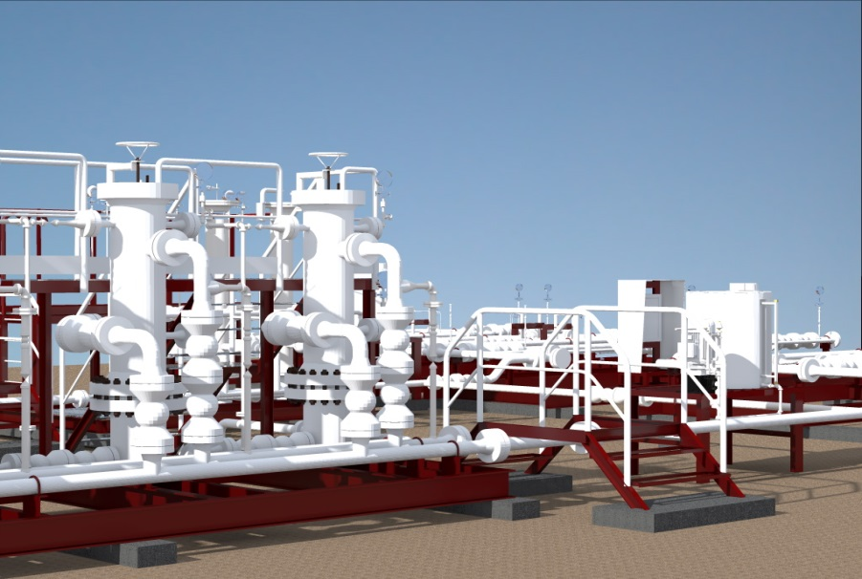
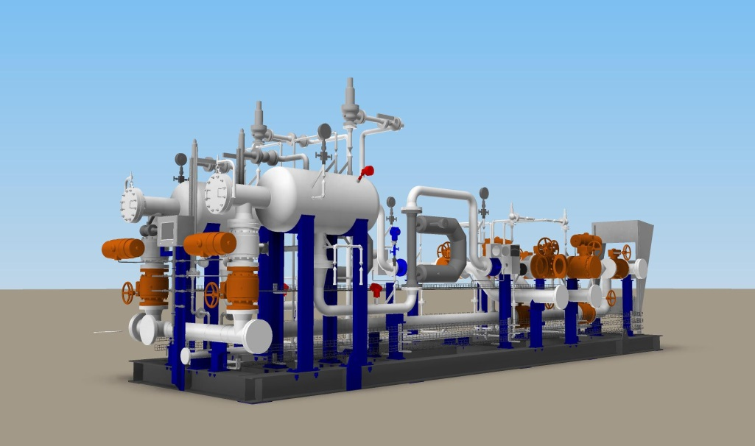
Areas of Expertise
Oil & Gas Industry
  Flow Lines
  Skid Design of Well Head Control Panel
  Skid Design of Manifolds
  Skid Design of Water & Chemical Injection System

Slide 14
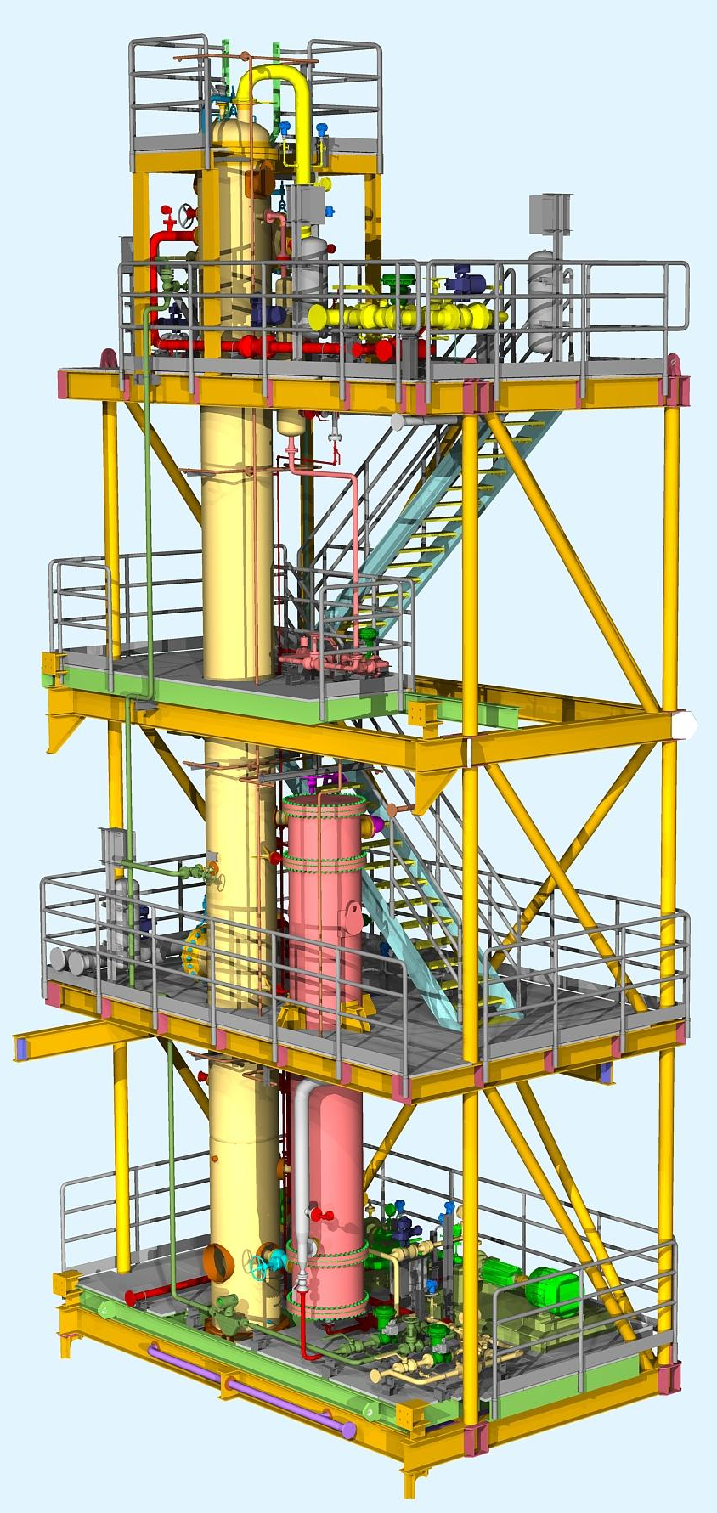
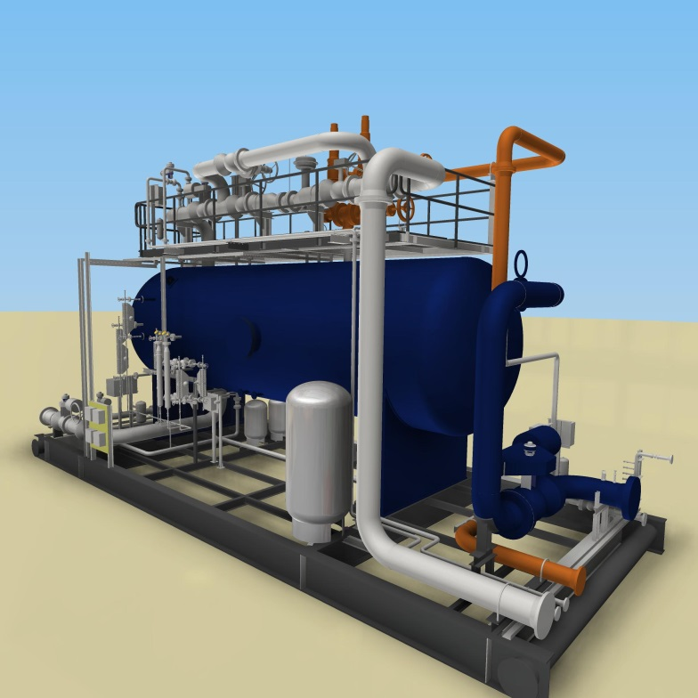
Areas of Expertise
Oil & Gas Industry
  Gas Oil Separation Unit
Three Phase & Two Phase Separation Units
Condensate Stabilization Unit
Gas Treatment (Dehydration Unit, Amine Unit…)

Slide 15
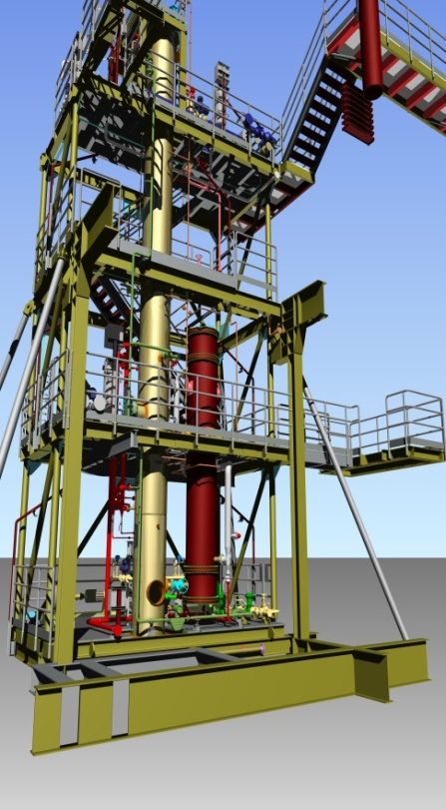
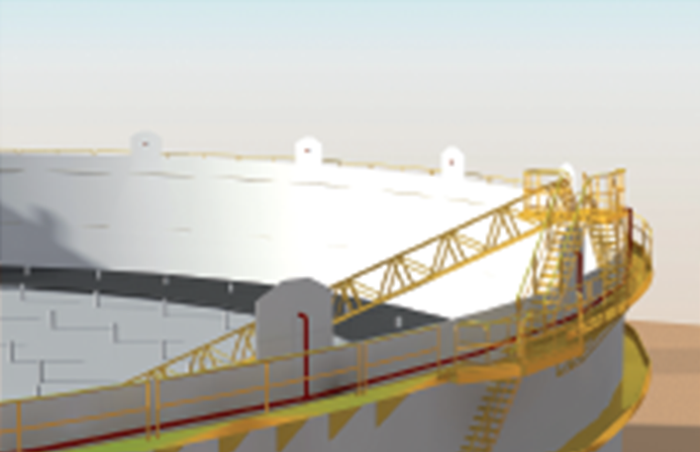
Areas of Expertise
Oil & Gas Industry
  Liquefied Petroleum Gas LPG
  Gas & Condensate Drying
  Depropanizer Columns
  Debutanizer Columns
  Storage & Flaring Facilities
  Crude Storage Farms
  LPG Storage Facilities: Sphere, Mounded Bullets
  Gasoline, diesel & Kerosene Storage Farms
  Fire Fighting Extinguishment & Detection
  Installation
  Flaring Installation: Burn Pit Flare System & Elevated
  Flare System

Slide 16
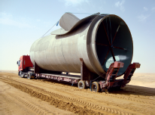
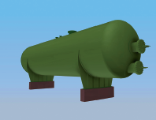
Areas of Expertise
Water Treatment
  Potable Water Pipeline & Pumping Stations
  Pumping Station & Surge Vessel Area
  Water Pipeline
  Regulating Station
  Desalination Unit
  Self Cleaning Filtration Systems (Sand Filter)

Slide 17
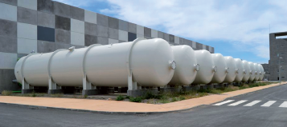
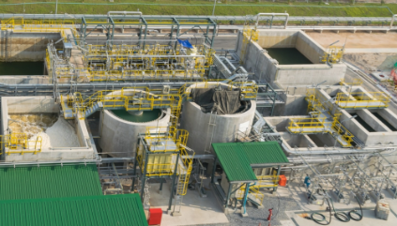
Areas of Expertise
Waste Water Treatment
  Industrial Water Treatments
  Produced Water Treatment
  Oily Water Separators
  Waste Water Treatment
  Waste water pre-treatment
  Batch reactors
  Sludge treatment and disposal

Slide 18
Summary
1
Overview
2
Activities
3
Areas of Expertise
4
References

Slide 19
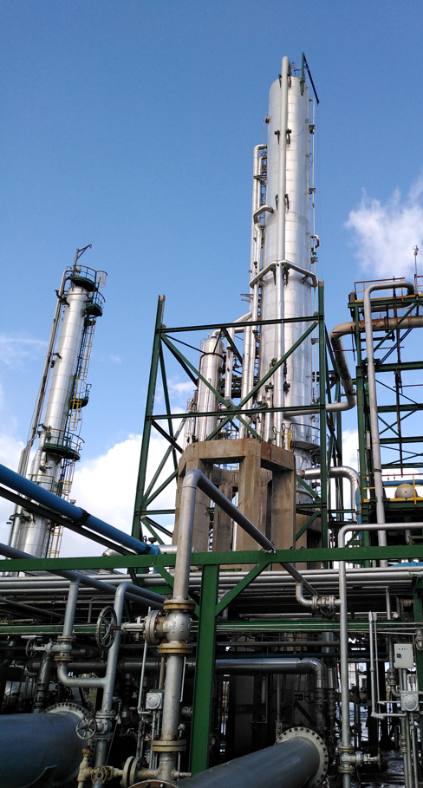


References
PROJECT : Development of Feasibility, Base and Front End Engineering Design for Topping Revamping Project
CLIENT : Studi Tecnologie Progetti STP - ITALY
OWNER : STIR - Tunisia
Notes:
Current project

Slide 20
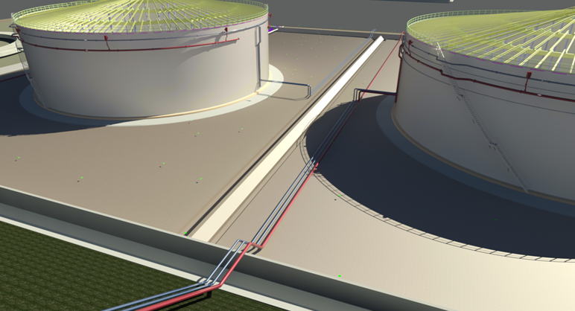
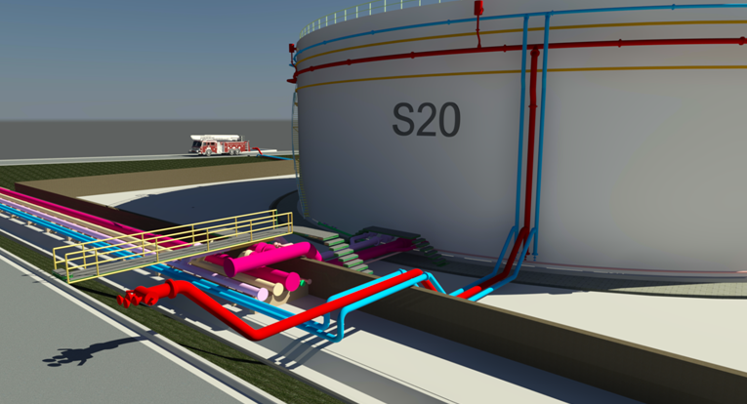
References
PROJECT : Design of Three (03) Hydrocarbon Storage Tanks 30.000m³ including Interconnecting Piping (Gasoil, Fuel Oil, Water Vapor and Firefighting)
OWNER : STIR
Notes:
2020-2021

Slide 21
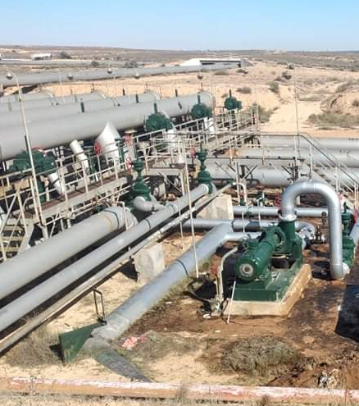

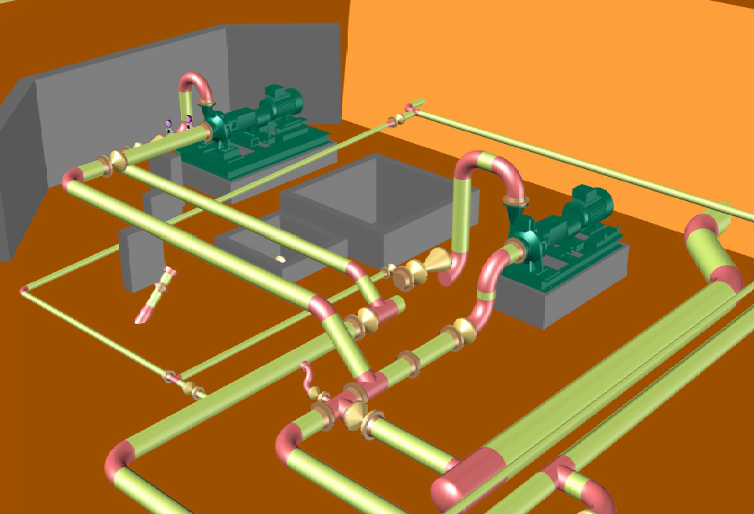
References
PROJECT : Design Study of Crude Oil Transfer Pump 500 m³/h
OWNER : TRAPSA
Notes:
2021

Slide 22
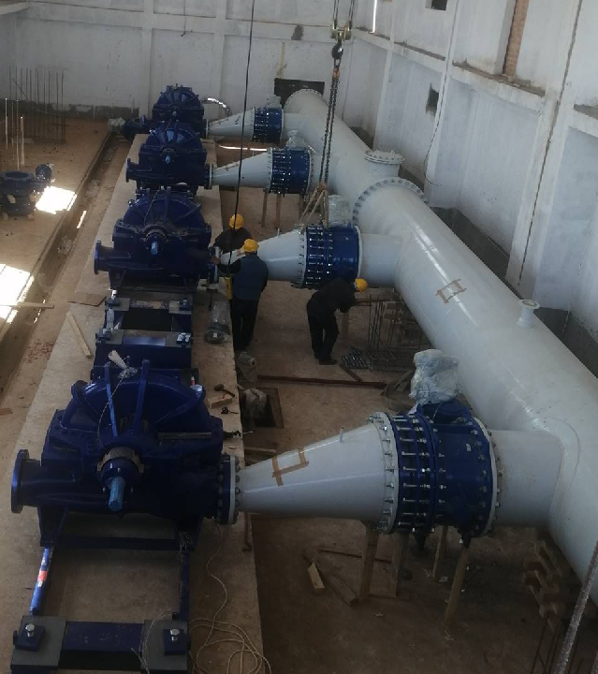


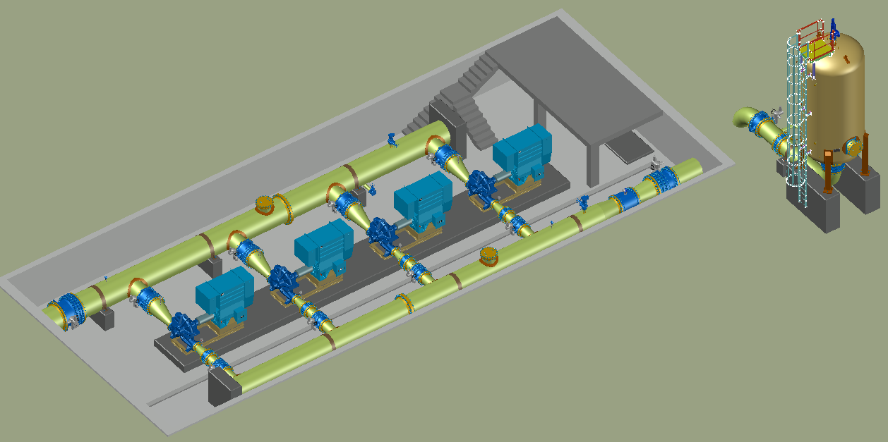
References
PROJECT : Pumping Station Design Study in Tlemcen
LOCATION : Algeria
CLIENT : KSB
OWNER : Algérienne Des Eaux
Notes:
2020

Slide 23

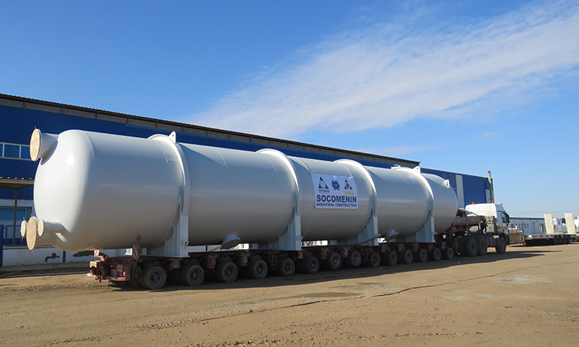
References
PROJECT : Design of 14 sand filters ( L:24.5m, D:4m) for Sousse Seawater Desalination Plant
CLIENT : SOCOMENIN
OWNER: SONEDE
Notes:
2019

Slide 24

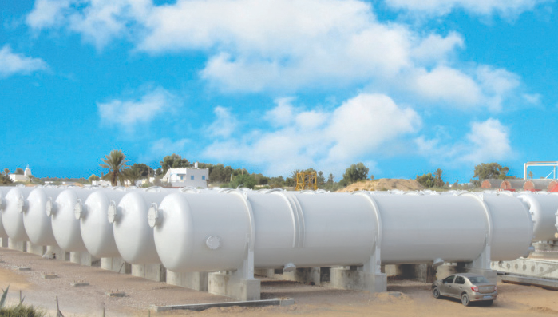
References
PROJECT : Design of 14 sand filters (L:24m, D:4m) for Djerba desalination
CLIENT : SOCOMENIN
CONTRACTOR : Aqualia - Spain
OWNER: SONEDE
Notes:
2019

Slide 25


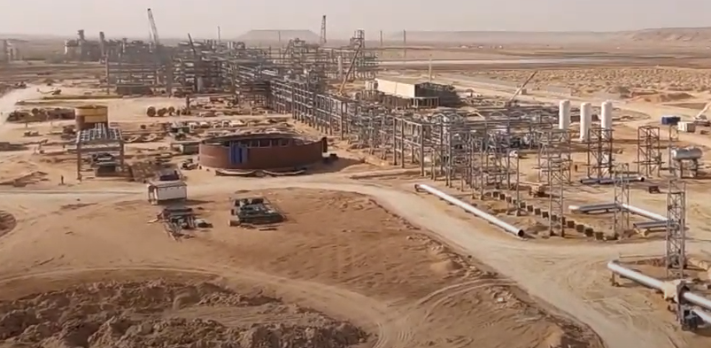
References
PROJECT : Design of Eight (08) Oil and Water Storage Tanks
Location : Algeria
Contractor : Socomenin
CLIENT : Petrofac
OWNER : Sonatrach
Notes:
2020-2021

Slide 26
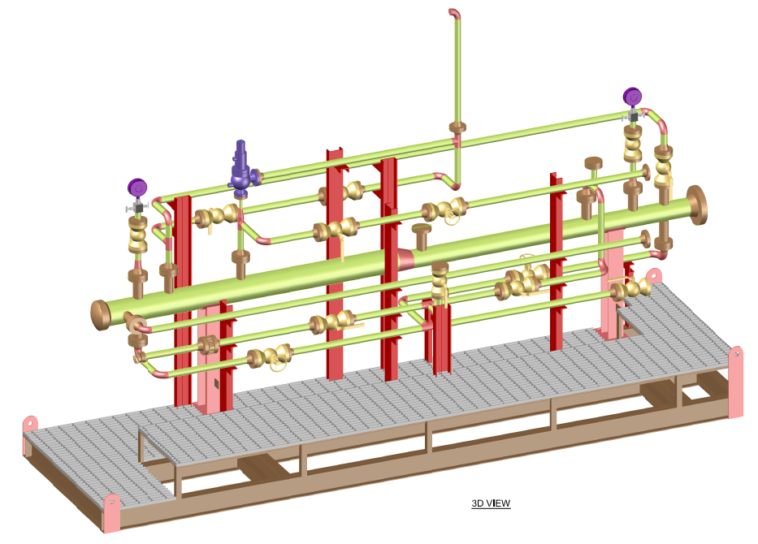
References
PROJECT : Design of 24 Mobile and Fixed Pig Launcher & Receiver
CLIENT : Petrofac
OWNER : Sonatrach - Algeria
Notes:
2020-2021

Slide 27

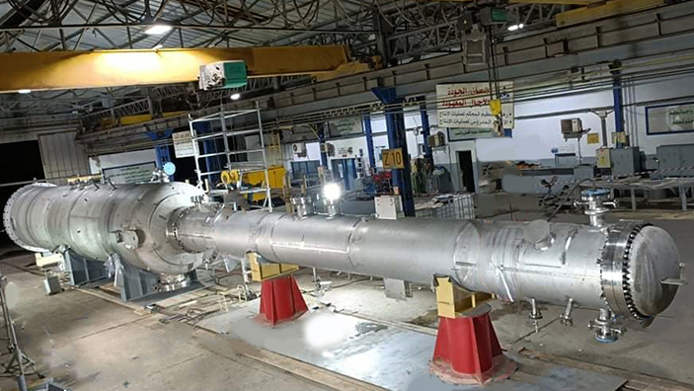
References
PROJECT : Design of Two 02 Reactors and 02 Quench Tower (Stainless Steel SA240 TP 310 S) ASME Stamped for Hydrogen Sulphhide (H₂S) Plant
CLIENT : Socomenin
OWNER : Ambatovy (Madagscar)
Notes:
2019

Slide 28
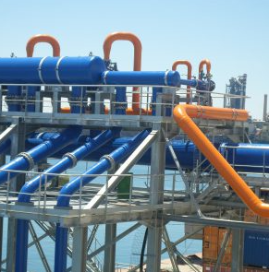


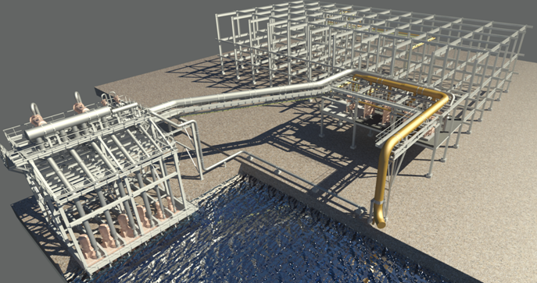
References
PROJECT : Design of Sugar Refinery 1 600 t/d Section 9 Filtration Pump Sea Water
CLIENT : GCER
OWNER : Tunisie Sucre

Slide 29
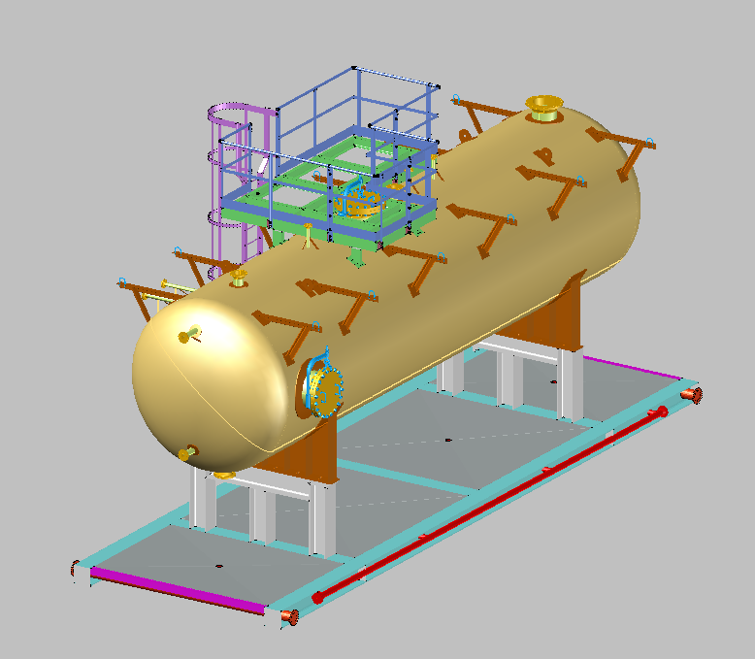


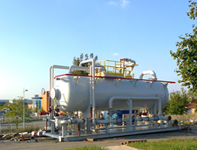
References
PROJECT : Design of Three Phase Horizontal Separator
CLIENT : MG Group
OWNER : PERENCO - Congo

Slide 30
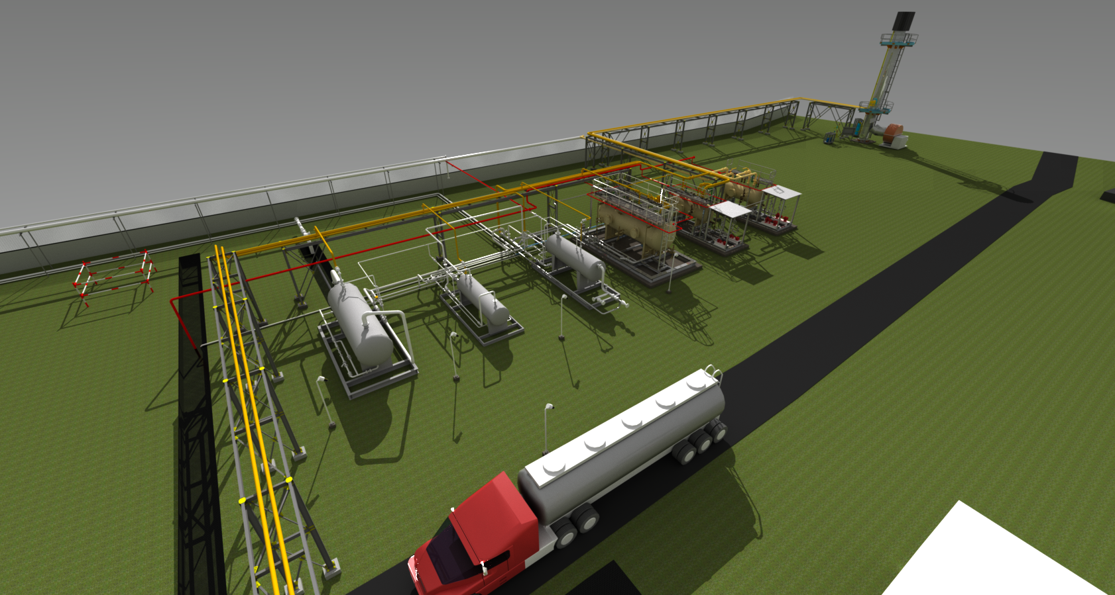

References
PROJECT : Guebiba Station Process & Flaring Improvement
CLIENT : SOCOMENIN
OWNER : THYNA PETROLEUM SERVICES (TPS)
Notes:
2015

Slide 31
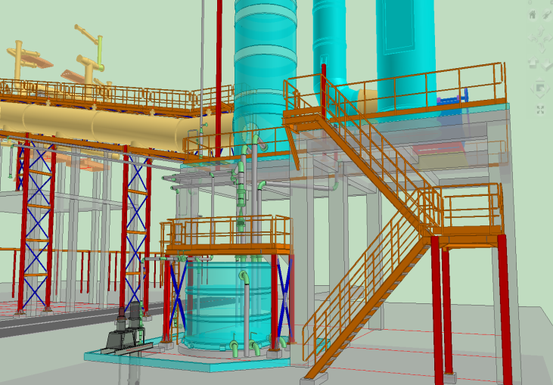

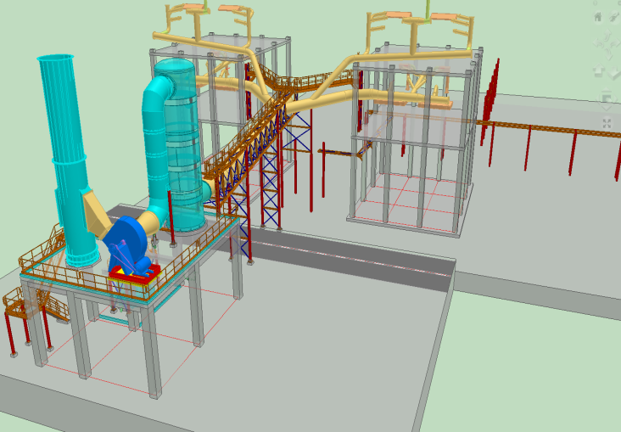
References
PROJECT : Design of TSP Grinding Unit Dedusting System
OWNER : GCT
Notes:
2012

Slide 32
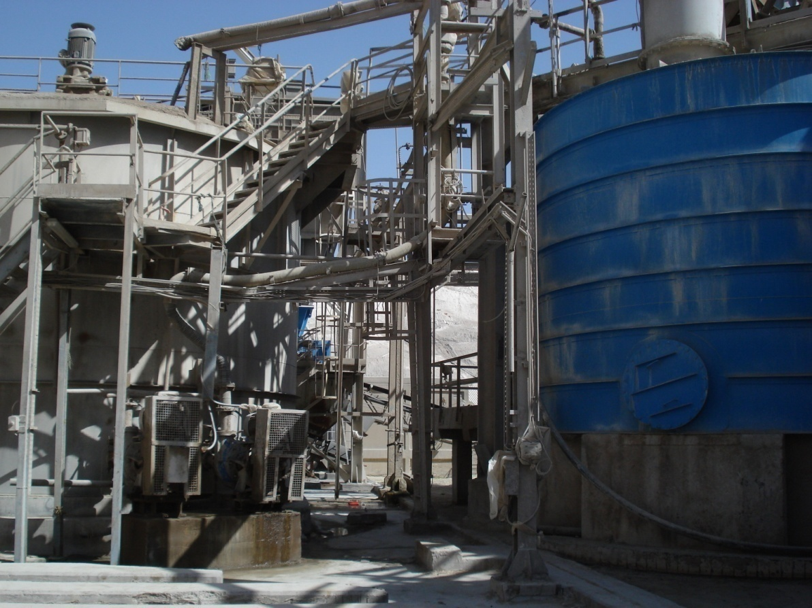
References
PROJECT: Design of Phosphoric Acid Reactor including Gas Scrubbing System
CLIENT : SOCOMENIN
Owner: GCT
Notes:
2009

Slide 33
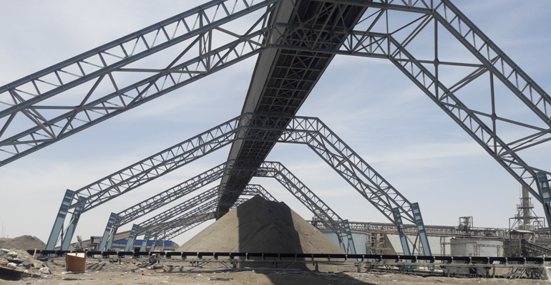
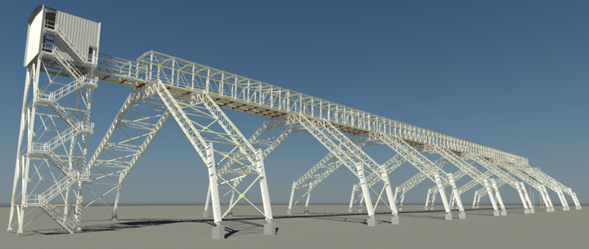
References
PROJECT : Engineering of Wet Phosphate Storage Unit (Skhira)
CLIENT : GCT
OWNER : GCT

Slide 34
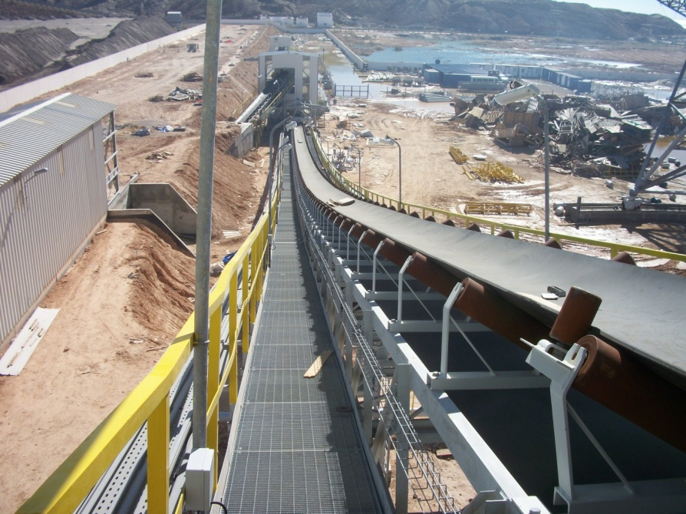

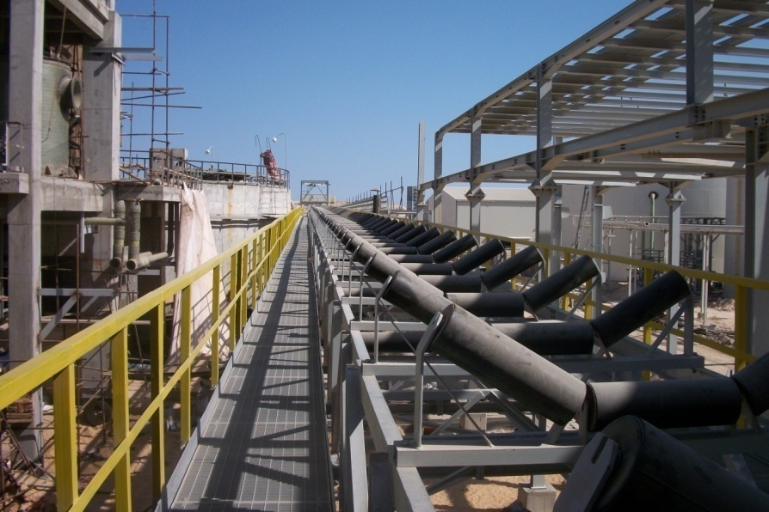
References
References
PROJECT : Design of Material Handling System for New Phosphoric Acid Plant
CONTRACTOR : TAIMWESER
OWNER : Tunisian Indian Fertilizers TIFERT

Slide 35
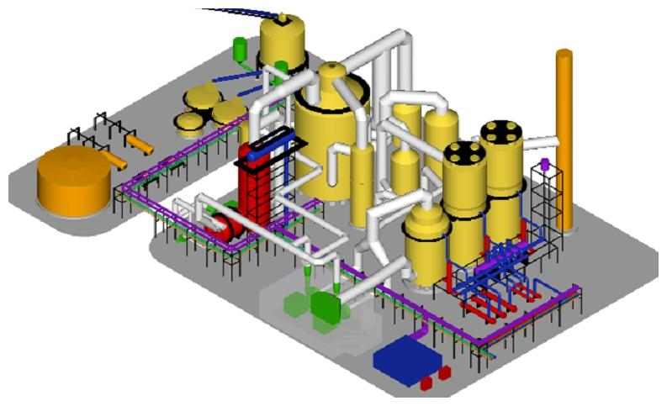
References
PROJECT : Design of Sulfuric acid plant 1800T/day for Mdhilla 2 Project
CLIENT : ECEC CHINA
Owner: GCT
Notes:
2011

Slide 36


References
PROJECT : Design of TSP M'DHILA 2 Plant
Contractor: Hyundai Engineering
OWNER : GCT

Slide 37
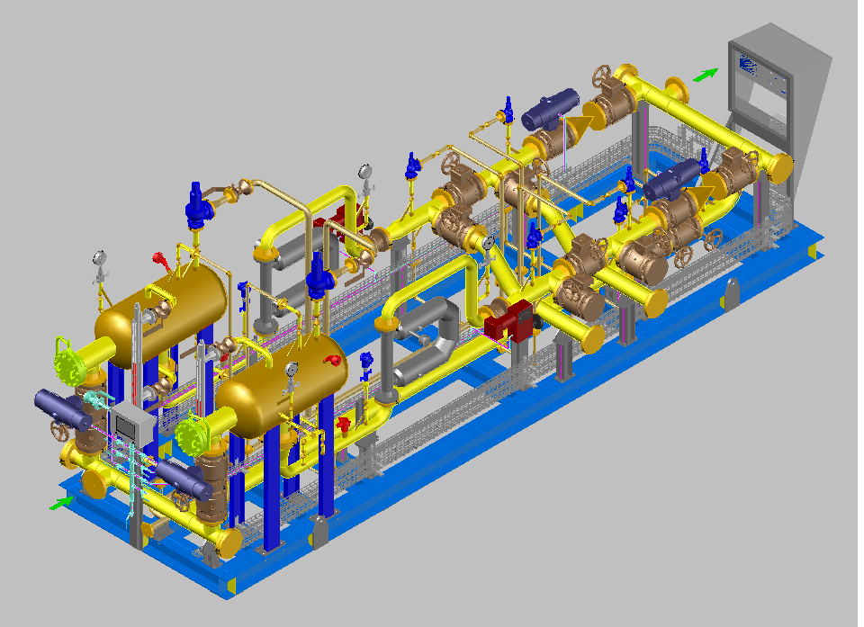
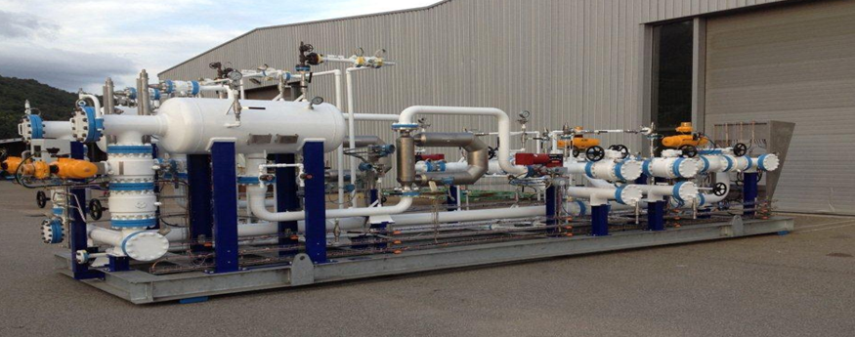
References
PROJECT : Metering Skid of Butane
CLIENT : ALMA
OWNER : BUTANE DE HAVRE
Notes:
2012

Slide 38
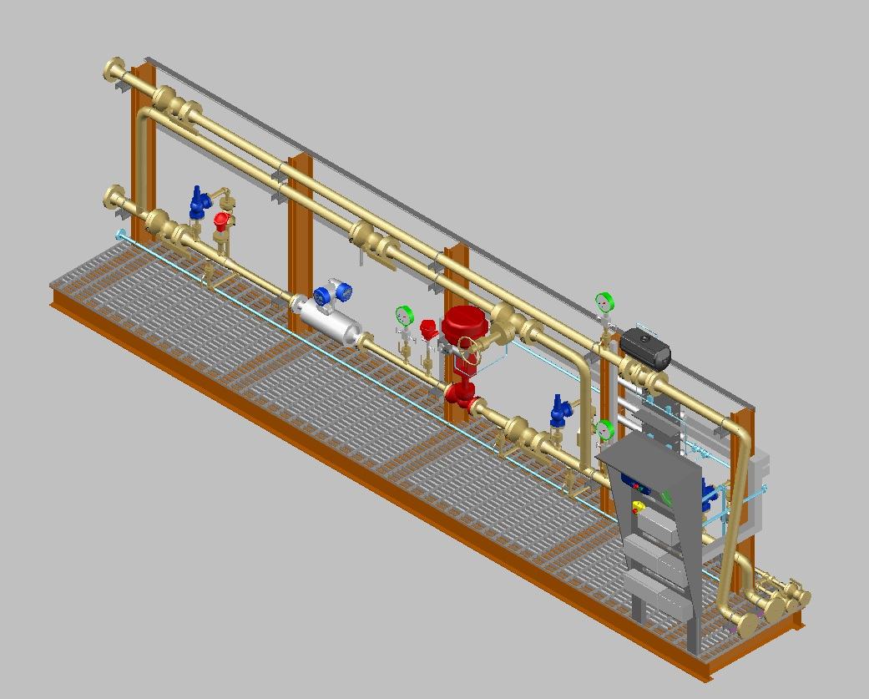
References
PROJECT : Design of Six (06) Load Skid of GPL & Propane
CLIENT : ALMA
OWNER : ENTREPOSE
Notes:
2012

Slide 39

References
PROJECT : Design of LPG Metering Skid
Contractor : ALMA
OWNER : Butane de Havre France
Notes:
2011

Slide 40


References
PROJECT: Design of 95.000 BBL Crude Oil Storage Tank at Zwetina Power Station
CLIENT : SOCOMENIN
OWNER : General Electricity Company of Libya (GECOL)
Notes:
2012

Slide 41

References
PROJECT : Package Design for Water Injection system at Central Mabruk Field
CLIENT : MABRUK OIL OPERATION
OWNER : TOTAL
Notes:
2012

Slide 42




References
PROJECT : Design of 500,000 USBBL Crude Oil Floating Roof Storage Tank
CLIENT : SOCOMENIN
OWNER : HAROUGE Libya
Notes:
2012

Slide 43


References
PROJECT : Design of Six (06) Separators and one Degassing Boot
CLIENT : Peerless Europe
Owner : HAROUGE Libya

Slide 44



References
PROJECT : Design of Two Skids for Pig Launcher & Pig Receiver
OWNER : SITEP

Slide 45


References
PROJECT : Detailed Design of Dedusting System for Kiln and Cooler
LOCATION : Tunisia
CONTRACTOR : FLSmidth
OWNER : CJO CEMENT - Djebel Oust
Notes:
2011

Slide 46





References
PROJECT : Design of Two (02) Oil Storage Tanks 30.000 m³
CLIENT : SOCOMENIN
Owner: TANKMED
Notes:
2011

Slide 47




References
PROJECT :
Design of four (04) Oil Storages Tanks 60.000 m³ including Manifold and Interconnecting Piping
CLIENT : SOCOMENIN
OWNER : TANKMED
Notes:
2011

Slide 48



References
PROJECT :
Design of 5 Oil Storages Tanks 104 000 m³ including Manifold and Interconnecting Piping
CLIENT : SOCOMENIN
OWNER : TANKMED
Notes:
2008

Slide 49

References
PROJECT : FEED Engineering of Stabilization Package Module (Z5105)
CLIENT : SEREPT
OWNER : SEREPT
Notes:
2010

Slide 50

References
PROJECT : Design of the Production Separator Package Z5103
CLIENT : SOCOMENIN
OWNER : SEREPT
Notes:
2010

Slide 51



References
CLIENT : 3B
PROJECT: Design of Fiber Glass Plant
Owner: Tunfib Tunisia
Notes:
2010

Slide 52


References
PROJECT : Design of Gas Pig Launcher & Receiver Abu Dhabi - UAE
OWNER : GASCO
Notes:
2010

Slide 53



References
PROJECT: Design of 8 Surge Vessels:
2 Surge Vessels 90 m³ - 40 BARS
3 Surge Vessels 250 m³ - 25 BARS
3 Surge Vessels 225 m³ – 25 BARS
LOCATION: ORAN-ALGERIE
CLIENT : SOCOMENIN
OWNER : ABB
Notes:
2009

Slide 54




References
PROJECT: Engineering Design of 7 Fuel Oil and Water Storage Tanks (2*3000 / 2*2000 / 2*500 / 1*100m³) for Ghannouch Power Station)
CLIENT : ALSTOM
Owner : STEG
Notes:
2010

Slide 55



References
PROJECT : Design of Expansion of Pellet Stock Yard
CLIENT : SOCOMENIN
OWNER: LISCO
Notes:
2008

Slide 56



References
PROJECT : Design of Flow Control Station, Regulating Station and Pressure Relief Station of Water Pipeline 500 km for kufra Water System
CLIENT : SOCOMENIN
OWNER : TEKFEN / GMMRA
Notes:
2008

Slide 57



References
PROJECT : Design of ALGORDABYA & ASSDADA Steel Buildings, Interconnecting Pipes and Miscellaneous Steel Structure
CLIENT : VINCI Construction
Owner: GMMRA Libya
Notes:
2006

Slide 58


References
PROJECT : Design of 24 HP Surge Vessels 250 m³ for Wadi Tumellah Surge Area
CLIENT : SOCOMENIN
CONTRACTOR: VINCI Construction
Owner: Gmmra (MMRA – Libya)
Notes:
2007

Slide 59



References
PROJECT : Design of Steel Manifold, Piping Spools, Special Fittings, Surge Vessels , Miscellaneous Steel Works of Pumping Stations PS1 & PS2 (TAZ Project)
CLIENT : SOCOMENIN
CONTRACTOR: Metis
OWNER: GMMRA
Notes:
2007

Slide 60



References
PROJECT: Design of 25 Sand Filters for Skikda, Beni SAF and Honaine Desalination Plant
CLIENT : SOCOMENIN
CONTRACTOR : GEIDA-UTE
OWNER : Algerian Energy Company AEC

Slide 61



References
PROJECT : Design of 20 Shop Fabricated Tanks (ASME STAMP)
LOCATION : Algeria
CLIENT : SOCOMENIN
CONTRACTOR : SNC Lavalin

Slide 62





References
PROJECT : Design of 18 Pressure Vessels according to ASME Stamp for Hasdrubal Gas Treatment Project. (Tunisia)
LOCATION : Tunisia
CLIENT : SOCOMENIN
OWNER : Petrofac / British Gas

Slide 63


References
Project: Design of 4 Atmospheric Tanks
2x10 000m³, 1800m³ & 500m³ in Berrouaghia Power Station
CLIENT : SAIPEM INDIA
OWNER : SONELGAZ ALGERIA

Slide 64



References
PROJECT : Detailed design of Circular Clinker Storage Building, Diameter 70m
LOCATION : Morocco
CLIENT : Polysius
OWNER : Bouskoura Cement Plant

Slide 65



References
PROJECT : Study of the Implementation of Metallic Silos for Cereals Board at Dahmani - Tunisia
CLIENT : Office des Céréales
OWNER : Office des Céréales

Slide 66


References
PROJECT : Structural Design of 4 Electrical Substations 220KV/60KV & 60KV/30KV
CLIENT : KAHRAKIB
OWNER : SONELGAZ ALGERIA

Slide 67


References
PROJECT : Design of 2 Manifolds (25 bars & 10 bars)
LOCATION : LIBYA
CLIENT : SOCOMENIN
OWNER : Al Naher CO.LTD Pipe / GMMRA

Slide 68


References
PROJECT : Study Draining Pipes System Unloading of Liquid Ammonia
CONTRACTOR : AXIMA - IET
OWNER : GCT
Notes:
2010

Slide 69

THANK YOU
FOR YOUR
ATTENTION

